Slide 1
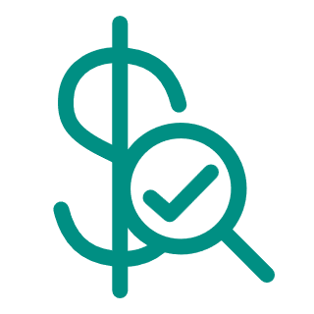
VERISAVE®
Pharmacy purchase optimization solutions that instantly save money and increase efficiencies.
Powerful functionality that automatically reduces your pharmacy spend.
The VERISAVE suite of pharmacy purchase solutions helps hospitals and healthcare facilities manage fluctuating drug costs to optimize and reduce drug spend. Verisave automatically finds the best priced products for you from the best vendor, then ensures you pay the right price by monitoring contracted and invoice pricing. Verisave empowers buyers to manage the best purchasing decisions at scale for significant savings.
5%
AVERAGE
SAVINGS
Verisave Product Select
Finds the best blended real-time price of every product in your order and updates it before your order is placed.
Multi-Vendor Select
Finds the best priced product across all your contracted drug vendors and automatically places new orders on your behalf.
Contract Price Validation
Finds any discrepancies between your invoice and your contracted order pricing to simplify corrections with your vendor.
Uses your current catalog data, not a retrospective look-back, to instantly find better prices.
Transparent reporting, including missed opportunities and order log showing every step taken for savings.
Buyer controls what is updated with formularies built into the process.
Patented technology on a HITRUST® certified platform.
Trusted and experienced account management and support teams.
the future of high-performing healthcare
Find out what Verisave can do for you.
Contact us at info@verity340B.com.
Call 800.581.1378 to speak with a representative.
© 2024 Verity Solutions Group, Inc. All rights reserved.

Slide 2
Over $1 million
saved in 2024 by a MA hospital with 907 beds using Verisave Product Select
Verisave Product Select
Multi-Vendor Select
All-in-one platform
Real-time KPIs & Trend Reporting
Real-time identification
Quick and Simple Implementation
Notes & Activity
For buyers of all health facilities who are challenged with the manual process of finding the best priced drug, Verisave Product Select instantly optimizes your savings by selecting and purchasing the best priced NDC before your order is placed.
Eliminates labor-intensive reviews among multiple software systems or spreadsheets
Instant results with state-of-the-art, rule-based technology
Allows for formulary and unit dose considerations, and manufacturer rebates
Works seamlessly with Verity 340B Split Billing software for mixed inpatient / outpatient settings and owned retail pharmacies
Replaces any drug after order is split based on accumulations where a lower price GPI equivalent is found (where applicable)
For buyers of all health facilities who are challenged with the time it takes to find the best priced product across contracted vendors, Multi-Vendor Select:
Instantaneously reviews your entire order
Finds the best priced product across all your contracted drug vendors
Manages highly configurable formulary and volume requirements
Automatically splits your original order, placing new orders on your behalf
Contract Price Validation
For all health facilities who are challenged with invoice prices that do not accurately reflect the contracted price, resulting in potential overpayments, Contract Price Validation:
Quickly identifies where contracted pricing is not invoiced correctly
Ensures financial accuracy and operational efficiency
Helps to simplify the correction process with the vendor
7% added savings in 2024 for
an academic medical center
VERISAVE®
Reduced costs.
Increased efficiencies.
Meaningful results.
© 2024 Verity Solutions Group, Inc. All rights reserved.

